Slide 1
BASIC HEMODYNAMICS: PRESSURE MEASUREMENT & NORMAL PRESSURE TRACINGS
Dr Harikrishnan G

Slide 2
Referrences
Grossman & Baim's Cardiac Catheterization, Angiography, and Intervention
Practical Cardiovascular Hemodynamics : Elias Hanna
Braunwalds Heart Disease 12th ed
Nishimura_carabello_2012_hemodynamics_in_the_cardiac_catheterization

Slide 3
Part-1
Basic physics and instrumentations
Characteristics of a pressure wave
Artifacts
Normal pressure tracings 1. Atrial pressure tracings 2. Venous pressure tracing 3. RV pressure tracing

Slide 4
Part-2
Pulmonary capillary wedge pressures
LV pressure tracings
Peripheral arterial pressure tracings
Applications of hemodynamics at present

Slide 5
Pressure wave
Complex periodic fluctuation in force per unit area

Slide 6
Basic physics
FUNDAMENTAL FREQUENCY:
Number of the pressure wave cycles in 1 second
For heart beat 1 cycle: onset of 1 systole to the next one
Eg:
1. For a heart rate of 60/minute, fundamental frequency→1Hz
2. For a heart rate of 120/minute → 2Hz

Slide 7
Basic physics
Harmonics
Multiple of fundamental frequency
Eg:
Let’s consider a sine wave of fundamental frequency 1HZ (HR:60bpm)
1st harmonic→ 1Hz
2nd harmonic → 2Hz
3rd harmonic → 3Hz

Slide 8
Basic physics
Eg:
For a HR of 120bpm → Fund frq: 2Hz
1st harmonic→ 2Hz
2nd harmonic → 4Hz
3rd harmonic → 6Hz

Slide 9
Basic physics
What is the importance of harmonics?
In a setting of hemodynamic pressure measurement, if we are able to detect up to the 10th harmonics.
Finer high frequency pressures can be detected
Wigger’s Principle

Slide 10
HIGH FREQUENCY PRESSURE TRACINGS
LV pressure tracing → End diastolic flick
Aortic tracing → dicrotic notch
RA tracing → C wave flick

Slide 11
Pressure measuring devices: Properties
Sensitivity
The ability to detect small changes in input signal
Ratio of amplitude of recorded signal to the amplitude of input signal
Rigid sensing membrane→ lower sensitivity
Flaccid membrane→ Higher sensitivity
Notes:
Instrumentation should be sensitive enough to respond to small input signal

Slide 12
Pressure measuring devices: Properties
Frequency Response
Ratio of output to input amplitude over a wide range of frequencies
Notes:
For an ideal detector, the frequency response must be constant for a wide range of frequency

Slide 13
Notes:
Amplitude: Output: imput ratio
Natural frequency: frequency at which, the fluid filled transducer system will oscillates the maximum

Slide 14
NATURAL FREQUENCY
Frequency at which, the fluid filled system oscillates maximum
Outputs will be terribly high at Nat frequency
Pressures cannot be assessed accurately at the natural frequency

Slide 15
NATURAL FREQUENCY
Notes:
The desirable frequency response must be within the highlighted portion
The accuracy can be increased by: increasing the natural frequency of the system
2nd is by reducing the response at natural frequency→ Damping

Slide 16
Notes:
Amplitude: Output: imput ratio
Natural frequency: frequency at which, the fluid filled transducer system will oscillates the maximum

Slide 17
Notes:
Amplitude: Output: imput ratio
Natural frequency: frequency at which, the fluid filled transducer system will oscillates the maximum

Slide 18
Notes:
Amplitude: Output: imput ratio
Natural frequency: frequency at which, the fluid filled transducer system will oscillates the maximum

Slide 19
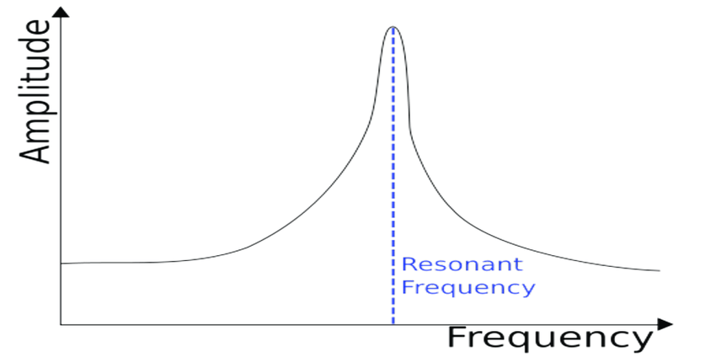
Notes:
Amplitude: Output: imput ratio
Natural frequency: frequency at which, the fluid filled transducer system will oscillates the maximum

Slide 20
DAMPING

Slide 21
DAMPING
The process of cutting down the output to input ratio progressively

Slide 22
DAMPING

Slide 23
Damped natural frequency of any transducer must roughly be 3 times the 10th harmonic of what we desire to record
Eg:
Pulse: 120bpm
Fundamental frequency→ 2Hz
10th harmonic→20Hz
Desired damped natural frq→ 60Hz

Slide 24
As the HR → The ability to detect the higher frequency

Slide 25
Higher Natural frequency
Shorter catheter
Larger lumen
Lighter Fluid
Non compliant rigid catheter
Greater Damping
Greater fluid viscosity
Smaller catheter radius

Slide 26
Conversion of pressure signals to electrical signals
STRAIN GAUGE
Variable resistance transducer
Principle:
Stretching electrical wire→ Increases the resistance to current flow

Slide 27
Wheatstone bridge circuit
At rest, all the resistances will be equal and output will be zero
When there is a strain or relaxation, the resistance is varied and an output is produced
Notes:
1. Electrical output delivered will be proportionate to the pressure input

Slide 28
Balancing the transducer
Done by adjusting the variable resistance
Balanced, such that electrical output is made zero when the pressure recorded is zero

Slide 29
PRESSURE MEASUREMENT SYSTEMS
Fluid filled system
Micromanometer catheter system

Slide 30
Fluid filled system
Fluid-filled catheter attached to a pressure transducer
Pressure wave transmitted by fluid column within catheter
Data collected with the patient in steady state, before introducing contrast
Transducers should be calibrated frequently before each recording

Slide 31
ZEROING THE TRANSDUCER
Placing the transducer at a level corresponding to the middle of level of the heart
Previously mid chest level was used
Now 5cm below the 4th LICS at the left sternal border

Slide 32
Calibration of transducer
Connecting the transducer to a 100mmHg standard pressure and calibrated.
Done automatically in the newer systems

Slide 33
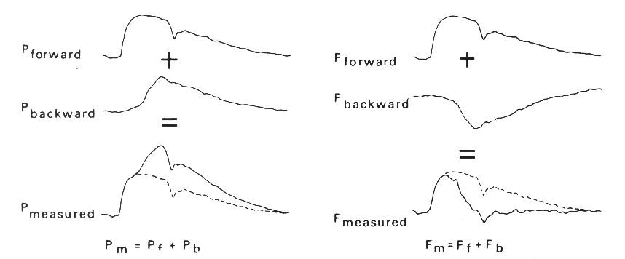
Reflected waves
Both pressure and flow at any given location are the geometric sum of the forward and backward waves
Notes:
Forward pressure wave and flow wave are identical
Measured central aortic pressure wave shows steady increase throughout ejection
At the same time, flow is reduced by modification by reflected wave (flow is directional)
Aortic flow measured by flow meters and doppler signals show reduced flow in late ejection

Slide 34
Reflected waves
Forward wave→ Due to the systolic pressure transmission
Backward wave→ Due to reflected wave from many sites within arterial tree (mainly region of terminal aorta)

Slide 35
REFLECTED WAVE AND EFFECT OF VALVALSVA
Strain phase of Valsalva
Pressure reflections are diminished
Pressure and flow waveforms looks similar

Slide 36
REFLECTED WAVE AND EFFECT OF VALVALSVA
Valsalva release
Reflected waves- exaggerated
Late peaking Central aortic and LV pressure tracings

Slide 37
Reflected waves

Slide 38
Clinical importance
Reflected waves are seen increased : in patients with HF
In normal persons, magnitude of reflected waves: don’t increase with exercise
Sodium Nitroprusside infusion: 1. ↓ Reflected wave amplitude & delay timing 2. Reduces the LV after load

Slide 39
Clinical importance
Concept of central pulse wave velocity

Slide 40
Augmented pressure wave reflection
Diminished reflection
Vasoconstriction
Heart failure
Hypertension
Aortic / iliofemoral obstruction
Post-valsalva release
Vasodilation (physiologic / pharmacologic)
Hypovolemia
Hypotension
Valsalva maneuver strain phase

Slide 41
Concept of Wedge pressures
Obtained when an end hole catheter is positioned in a designated blood vessel
While the end hole facing a capillary bed
No connecting vessels in between the tip of catheter and the capillary bed
True wedge pressure : Measured in the absence of flow

Slide 42
Concept of Wedge pressures
Absence of flow→ equilibration of pressure across the capillary bed
So catheter-tip pressure = Pressure on the other side of the capillary bed
Notes:
Wedge Hepatic venous P = Portal pressure
PCWP= LA pressure

Slide 43
Errors and artifacts
Tachycardia
Heart rate increases → Fundamental frequency of heart increases
Eg: HR increasing to 180bp
Frequency → 3HZ
10th Harmonic → 30Hz
In order to detect high frequency waves→ the natural frequency should be 90-120Hz
Notes:
Seen in situations where the catheter tip touching the myocardium induces a VT
Unable to detect high frequency deflections

Slide 44
Underdamping
Peak of LV systole overshoots >30mmHg
Dip of early diastole → -20mmHg
Tall peaks and deep troughs

Slide 45
CATHETER WHIP ARTIFACT
Motion of tip of the catheter within the measured chamber
→ Enhance the fluid oscillations of the transducer system
May produce superimposed waves of ±10 mm Hg
Particularly common in PA

Slide 46
END PRESSURE ARTIFACTS
Seen in end-hole catheter
Flowing blood- sudden halt- KE is converted to pressure
This added pressure may range from 2-10 mm Hg
2 Types End hole catheter upstream End hole catheter downstream (suctioning effect)

Slide 47
CATHETER IMPACT ARTIFACT
When the catheter is struck by the walls or valves of the cardiac chambers.
MV hitting the pigtail catheter in LV during early diastole

Slide 48
Peripheral systolic amplification
Due to the reflected wave
Peak SBP becomes higher as we go to peripheral arteries
Aortic peak SBP< Femoral, RA

Slide 50
Micromanometers
Fluid filled system-distortion of wave forms- artifacts, amplification of systolic pressure in periphery, damping or augmentation of frequency response system.
For precise, undistorted ,high fidelity pressure recordings
Micromanometer chips at the end of catheters
Interposing fluid column is eliminated

Slide 51
Micromanometer
Higher natural frequencies and more optimal damping
To assess pressure waveform contours in a tachycardia situation, rate of ventricular pressure rise(dp/dt) etc
Limitation- additional cost, fragility , time needed for properly calibrating and using the system

Slide 53
NORMAL PRESSURE WAVE TRACINGS

Slide 55
ATRIAL PRESSURE TRACING

Slide 56
Notes:
What each wave represent
How to identify based on ECG timing?
A- wave is like a flick, V-wave is like a dome

Slide 57
ATRIAL PRESSURE TRACING
Mean atrial pressure
Average instantaneous pressure of all the waveforms (area under the curve)
Lower than A and V pressures
Normal RAP </= 7mmHg

Slide 58
ATRIAL PRESSURE TRACING
Right atrial pressure
Left atrial pressure
A- wave more prominent than V-wave
More compliant
Larger size
Larger RA Appendage
V- wave is more prominent than A- wave
The space is limited→ less compliant
Tethered posteriorly by 4 Pulm. Veins
Anteriorly by mitral annulus

Slide 59
RESPIRATORY VARIATION

Slide 60
RESPIRATORY VARIATION
Fall in intrathoracic pressure → Fall in intracardiac pressure
Constrictive pericarditis
Respiratory increases in RV blood inflow → Increased RV ejection
RV pathology: RV CMP, RV MI, Pulmonary embolism
Increased pulmonary artery compliance due to expansion of space
Pulmonary embolism

Slide 61
In inspiration
RAP and V wave gets higher
Y wave becomes deeper
Indicates reduced RA compliance
Characteristic M or W pattern
CONSTRICTIVE PERICARDITIS
Deep x and y descents
Y being 5-10 mmHg lower than V

Slide 62
Diastolic pressure equalization of all chambers with that of pericardial pressure
No filling of the ventricles in diastole
Cardiac tamponade
Absent y descent
Prominent X decent
Notes:
Deep x- descents
Absent y-descents
Pericardial tamponade

Slide 63
TRICUSPID REGURGITATION
Peaks during the ST-T segment
‘ventriculisation’ of RAP
CV waves
V wave is large and wide

Slide 65
RA PRESSURE AND DOPPLER TRACINGS OF IVC, HEPATIC VEIN

Slide 66
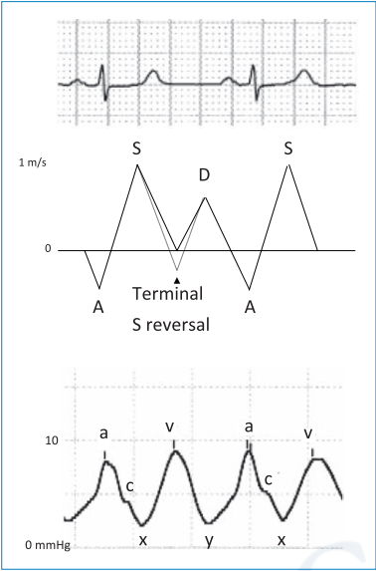
RA PRESSURE AND DOPPLER TRACINGS OF IVC, HEPATIC VEIN
The X and Y descents “suck” flow from the venous system →Leads to forward venous flow
A and V ascents attenuate forward venous flow and may reverse it.
X decent → S wave
Y decent → D wave

Slide 67
A-wave → Atrial A reversal on hepatic vein/IVC
V-wave→ late part of S-wave (slowing of systolic flow)

Slide 68
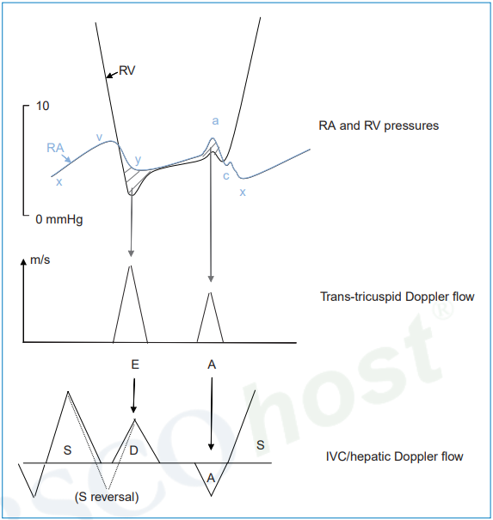

Slide 69
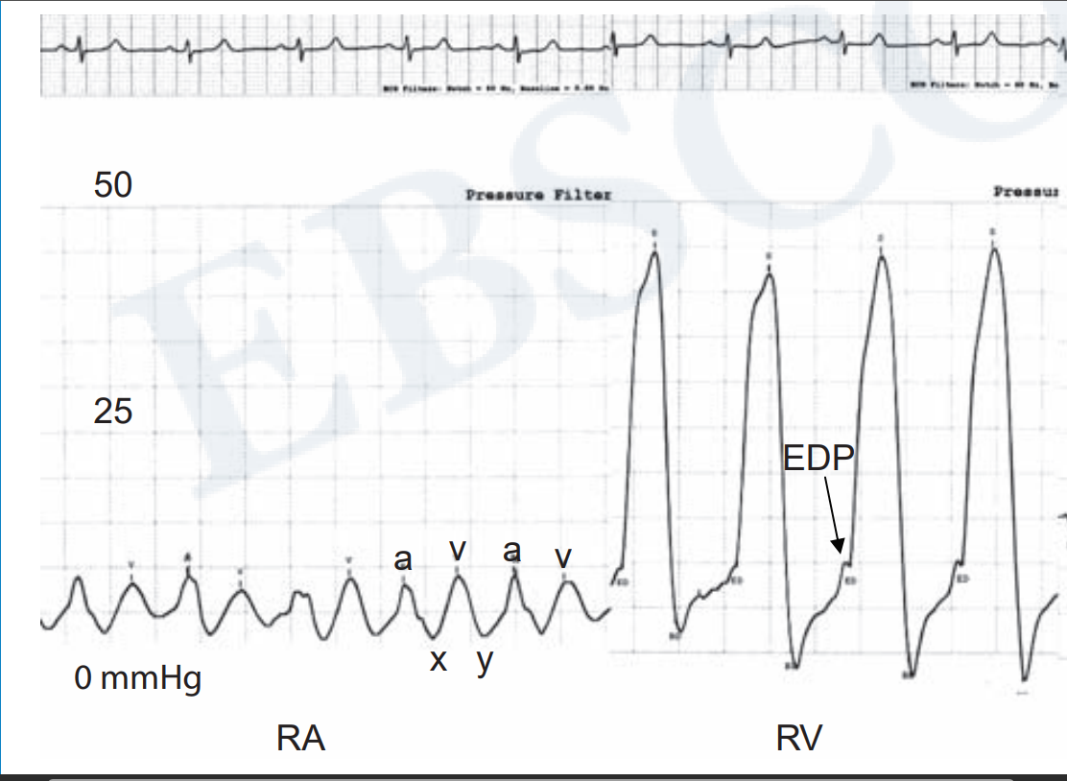
RV PRESSURE TRACINGS
</= 35mmHg
</= 8mmHg

Slide 70
A high early RA-RV pressure gradient can be normally seen in young individuals who have a potent RV relaxation (“suckers”)

Slide 72
Seen in decompensated HF
Elevated RA pressure push blood into RV (“Pushers”)

Slide 73
RV Pulsus alternans
Early RV diastolic dip
Not a healthy “sucking” dip
Represents, poor RV compliance
Plateaued high diastolic pressure

Slide 75
PULMONARY ARTERY PRESSURE TRACINGS

Slide 76
More triangular configuration
Has a dicrotic notch
Pressures decreases on diastole
Never touches the zero (baseline)
Normal PA pressure 35/12mmHg
Mean pressure: 20 mmHg

Slide 78
PART-2

Slide 79
THANK YOU

Slide 80
PULMONARY CAPILLARY WEDGE PRESSURE
Obtained by inflating the balloon-tipped catheter in the distal PA position until it occludes the PA branch
Represents the LA pressure
Notes:
Stagnant column of blood beyond balloon
This column has equal pressure of Pulmonary vein and LA

Slide 81
Does it represent the actual LA pressure changes?
Mean PCWP = Mean LA pressure
PCWP is delayed 50-150 milliseconds to that of LA pressure
Smoother contour: less deep X and Y descents (Damping)
Normal PCWP: </= 12 mmHg
Notes:
1. Delay is due to delay in transmission retrogradely from LA to branch Pulm A

Slide 82
PITFALLS IN INTERPRETING PCWP
Normally: PCWP ≤ PA diastolic pressure
This relationship is maintained in most disease states
Pulmonary venous HTN: PCWP ≈ Diastolic PA pressure
Pulmonary artery hypertension: PCWP ≥ Diastolic PA pressure

Slide 83
Condition in which PWCP > PA diastolic pressure?

Slide 84
However, mean PCWP greater than diastolic PA represents
A damped PA pressure tracing
Catheter’s being wedged in zone 1 or 2 of the lung

Slide 85
Wedging in zone 1 and 2, PCWP reflects the alveolar pressure rather than capillary pressure
It can be higher than PA diastolic pressure
PA catheter should ideally be wedged in Zone 3
Corresponds to level below LA on a 90 degree lateral view

Slide 86
Zone 1 and 2 expands in case of mechanical ventilation (increased PEEP)
Or in Low LA pressure )(hypovolemia)

Slide 88
Conditions were PCWP stimulate PA pressure
Presence of large V wave : Severe MR
Severe PAH
Not wedging the catheter properly

Slide 89
Abnormalities of PCWP
Large V wave
10 mmHg higher than mean PCWP
Larger than twice mean PCWP

Slide 90
Large V waves
Decompensated LV failure
VSD
MS
Impaired atrial compliance
Atrial fibrillation

